Slide 1

Optimization of Pharmaceutical Supply Chain & Bidding Process
APOTEX
Innovating for
patient affordability
J. Choi
Y. Choi
K. Eo
I. Yoon

Slide 2

Case
Introduction
The U.S. generic market is predominantly driven by a bidding process
A significant portion of Apotex global business is gained through customer bids.
With over 50 generic competitors operating in the U.S. market, it is a highly competitive and challenging market to operate in.

Slide 3

Process Overview
The current process of evaluating a bid requires input and approval from several cross- functional teams.
Proper supply chain assessment is performed prior to the decision to pursue a bid as the inability to fulfill the details of a contract could lead to significant Failure to Supply penalties.

Slide 4

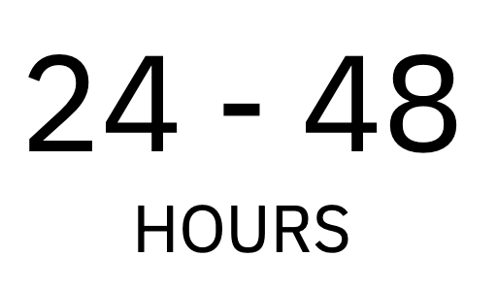
Process Overview
The current process of evaluating a bid requires input and approval from several cross- functional teams.
Proper supply chain assessment is performed prior to the decision to pursue a bid as the inability to fulfill the details of a contract could lead to significant Failure to Supply penalties.

Slide 5
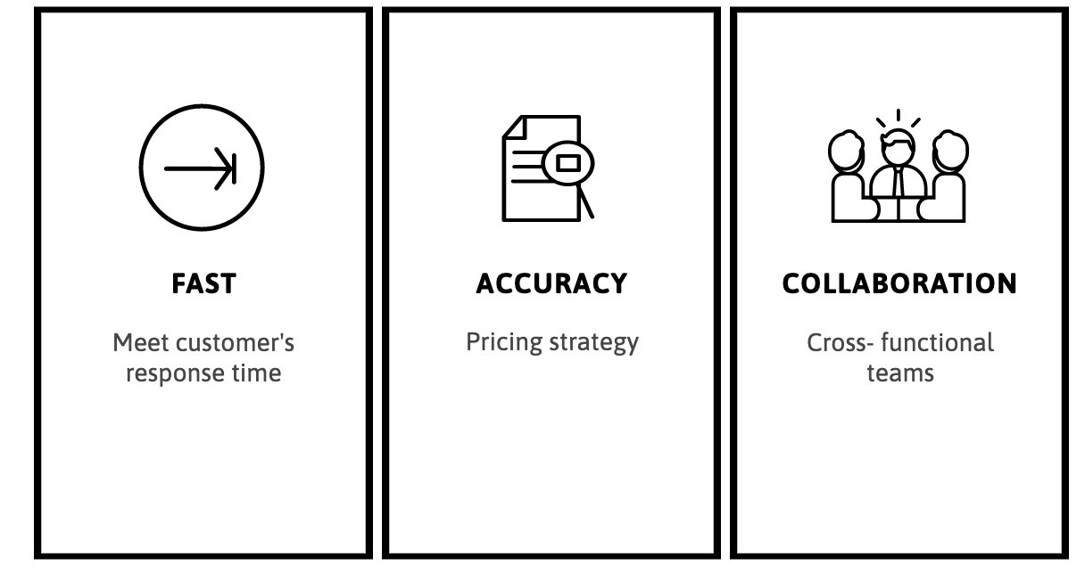
Key to Success
The current process of evaluating a bid requires input and approval from several cross- functional teams.
Inability to fulfill the details of a contract could lead to significant Failure to Supply penalties.
Portfolio, relationships, service, and bids response time.

Slide 6


Model 1: Win Rate Predictor
Purpose: Predict the winrate of a (new or existing) bid based on historical data sets.
Approach: Whitebox (Logistic Regression) + Blackbox (XGBoost)

Slide 7
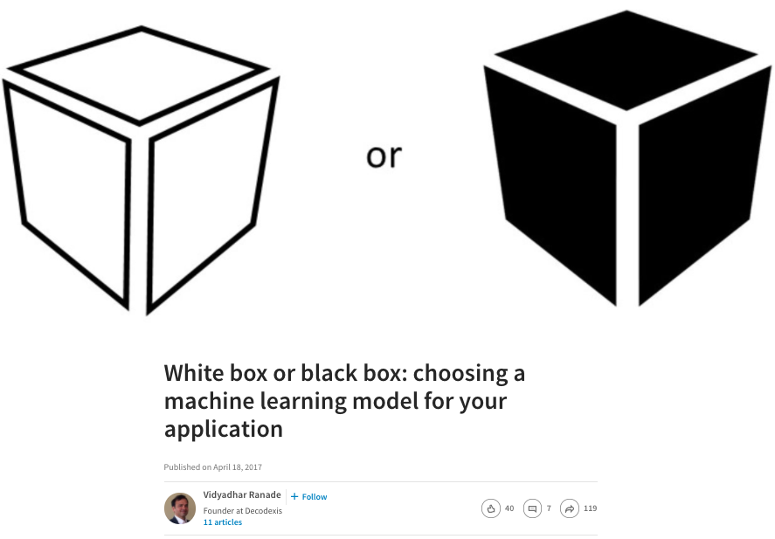
Model 1:
Learning Algorithm Selection
White box training:
ML Model that can be put into a form understandable by humans and attach interpretation within process.
Understand Internal process
Examples:
Logistic Regression
Linear Regression
Lasso
Bayes-Gaussian
Black box training:
Defies explanation of its inner workings.
Data-driven approach to learn complex interaction models
Examples:
Neural Network
Random Forest
Boosted Tree

Slide 8
Model 1:
Parameter Selection and Evaluation
Estimated parameters
Market Share
Number of Competitors
Fail to Supply Rate per Unit
Annual Units
Monthly Units
WAC price
Forecast

Slide 9
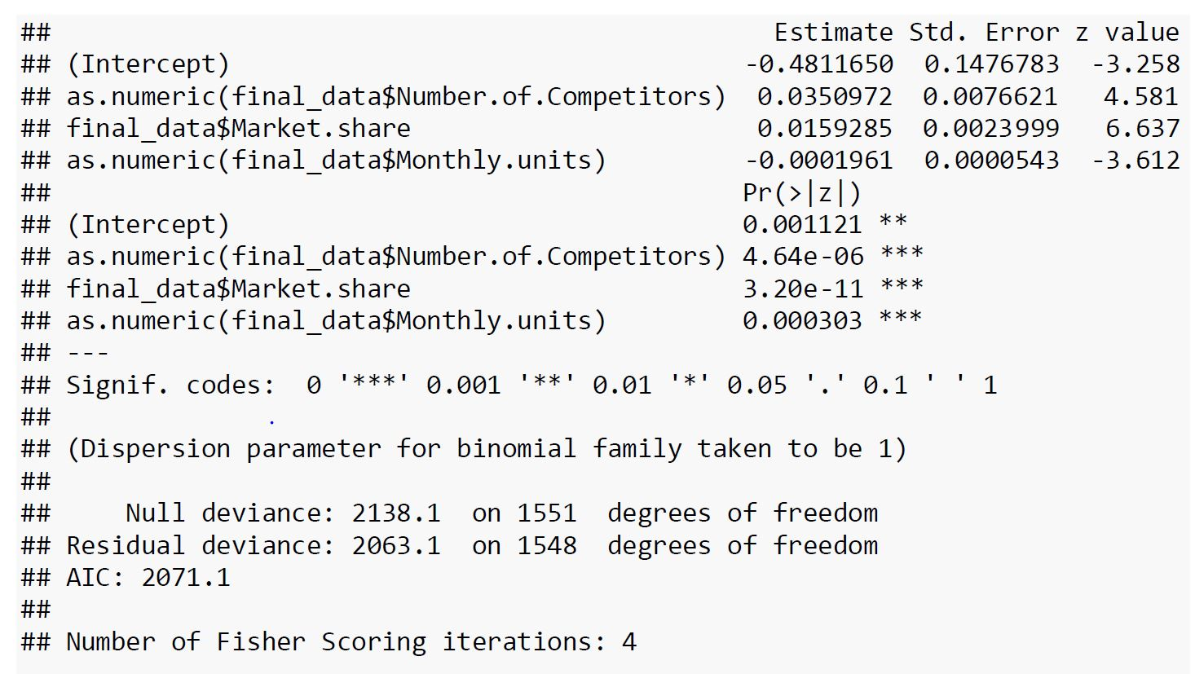
Model 1:
Parameter Selection and Evaluation
Using backward selection.

Slide 10
Model 1:
Parameter Selection and Evaluation
Logistic regression Model
dfafsa
with AIC: 2071.1

Slide 11
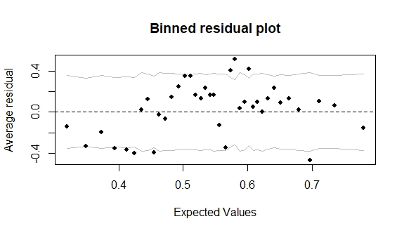
Model 1:
Parameter Selection and Evaluation

Slide 12
Model 1:
Learning Algorithm Selection
Algorithm | Reasoning
Linear Regression | Sensitive to outliers and unable to learn sophisticated level of input-output relationship
Logistic Regression | Elegant way of classifying binary outputs (win or lose), however, lack of prediction accuracy
MLP or Neural Network | Requires hyperparameter modification, senses subtle feature relationships. Very long PT.
XGBoost | Ability for strict learning algorithms for precise prediction, boosting by linear or tree available. Variable Importance can be determined.

Slide 13
Model 1:
Parameter Selection and Evaluation
Initial XGBoost model built with Binary classifier (“Won” or “Lost”), using parameters indicated in GLM.

Slide 14
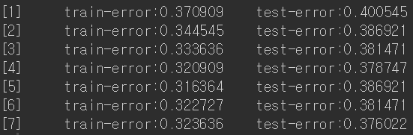
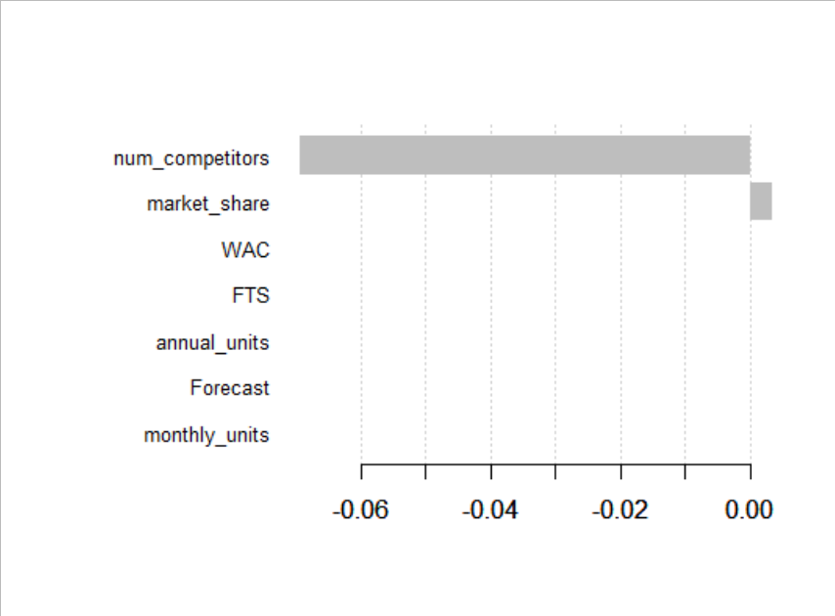

Model 1:
Boosting Evaluation
Linear vs. Tree Boosting
2. Linear Boosting

Slide 15
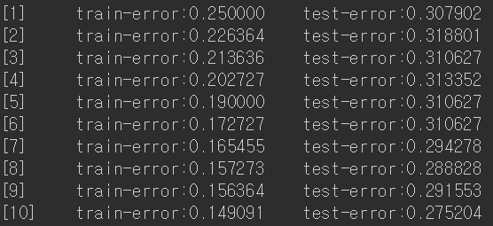
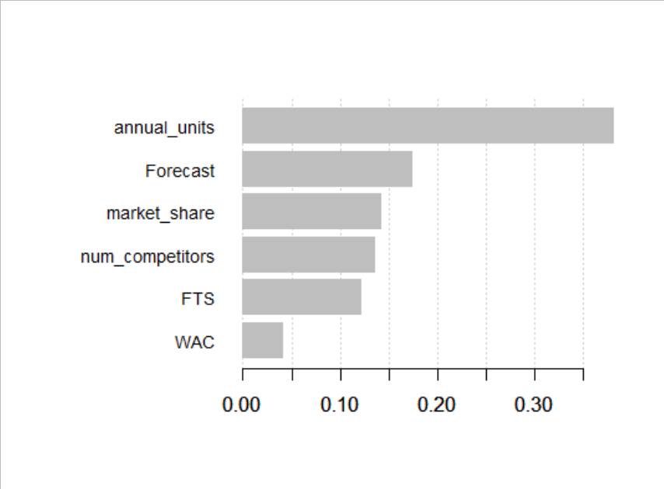

Model 1:
Boosting Evaluation
Linear vs. Tree Boosting
3. Tree Boosting

Slide 16
Model 1:
Model Optimization
4. Model Optimization
γ = minimum loss reduction threshold manipulation
nrounds = rounds of boosting iterations
watchlist implementation (model evaluation)
max_depth = maximum depth of each tree
… Current Model → ~73% prediction rate
can be further optimized by data subset (by family, customer), additional feature extraction, etc

Slide 17
Demand Forecasting
Forecasting: Making estimates of future based on historical data
Demand: Requirements of product or service from customers

Slide 18
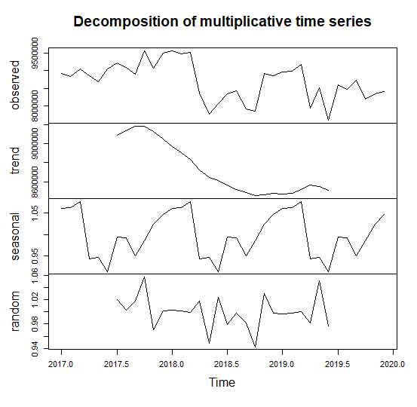
Time Series
Factors
Seasonality: Short term fluctuation of data
Trend: General tendency of data to change
Error: Unexpected events affecting the model

Slide 19
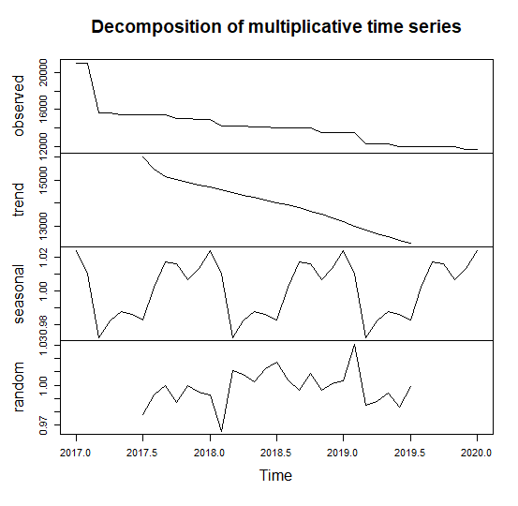
Model Selection
Choice: Product family with the highest number
of records (Product Family 332)
Reasoning: Similar time series characteristics

Slide 20
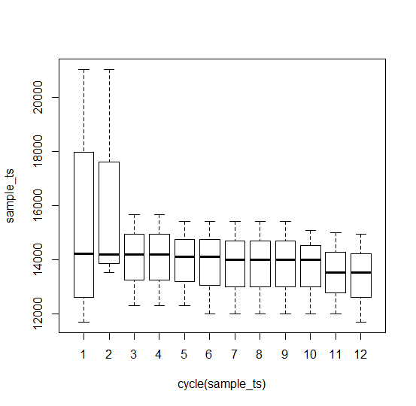
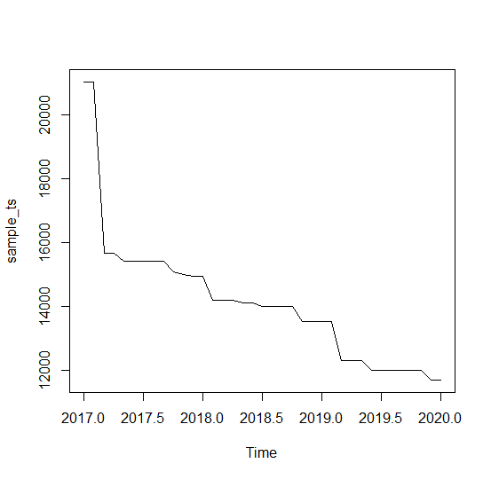
Seasonality and Trend

Slide 21
Method: ARIMA
Autoregressive: Statistical model that predicts future based on past
Model forecasting of time series which can be made stationary

Slide 22
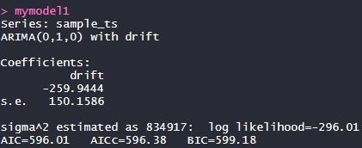
Performing
ARIMA(0,1,0)
Testing:

Slide 23
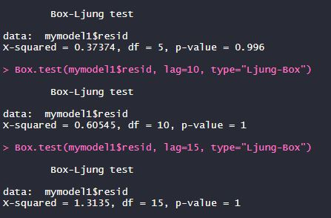
Check
Cannot use the model to fit right away
Autocorrelation: Error term in the ARIMA model
Box-Ljung test

Slide 24
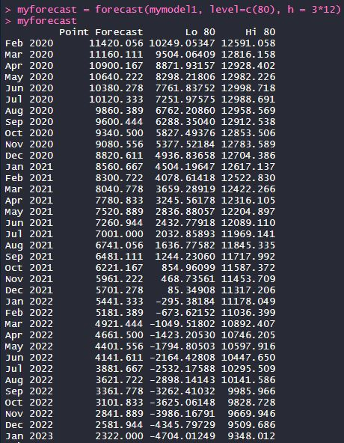
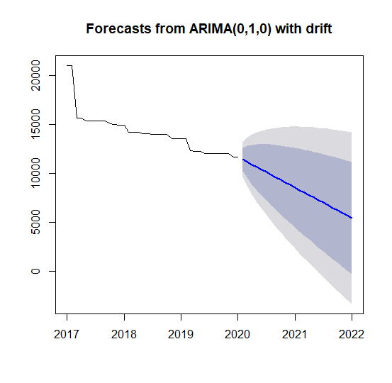
Forecasting

Slide 25
Conclusion
There will be a decrease of forecast of product family 332 in the future.

Slide 26
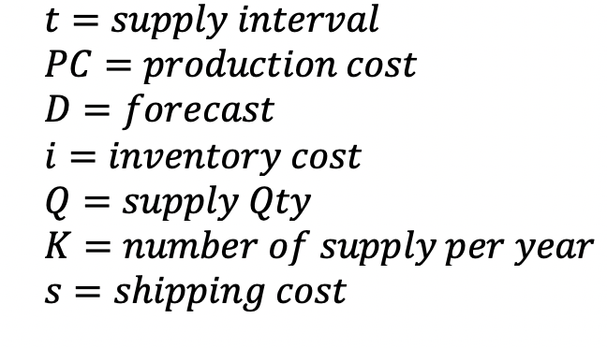
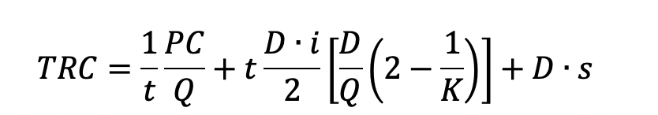
Supply Cost Optimization
Purpose: Find the optimum supply quantity to reduce costs involving inventory, production, shipping

Slide 27
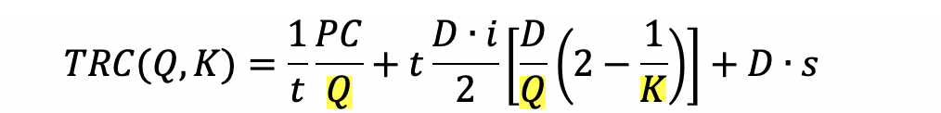
Supply Cost Optimization
Purpose: Find the optimum supply quantity to reduce costs involving inventory, production, shipping

Slide 28
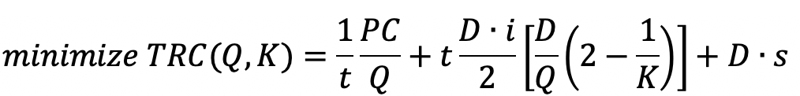
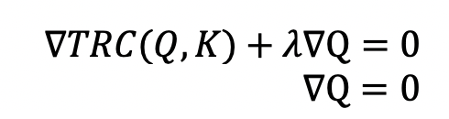
Supply Cost Optimization

Slide 29
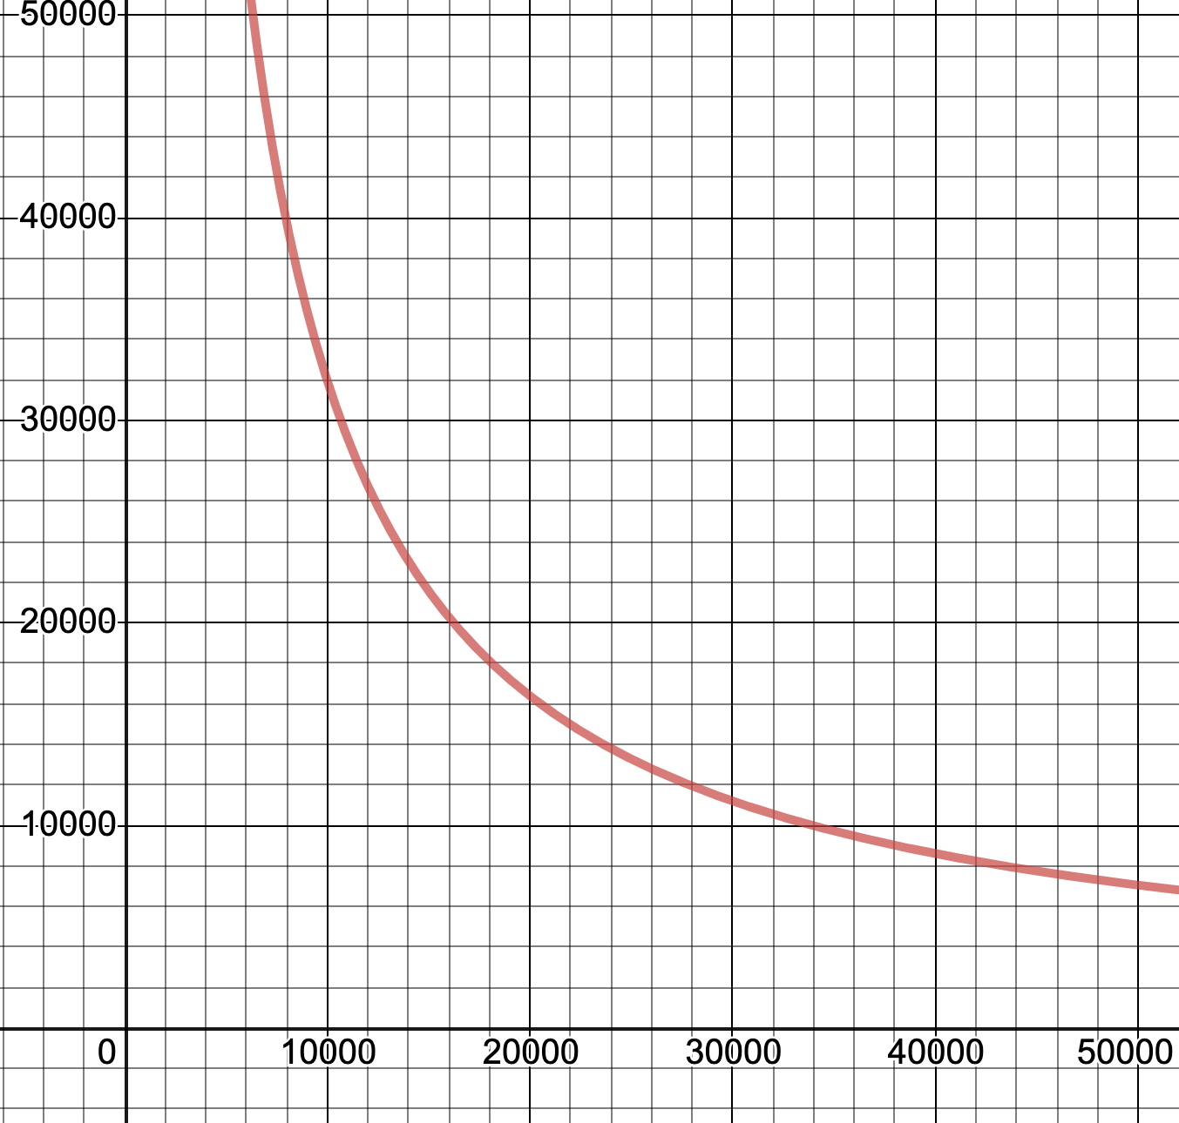
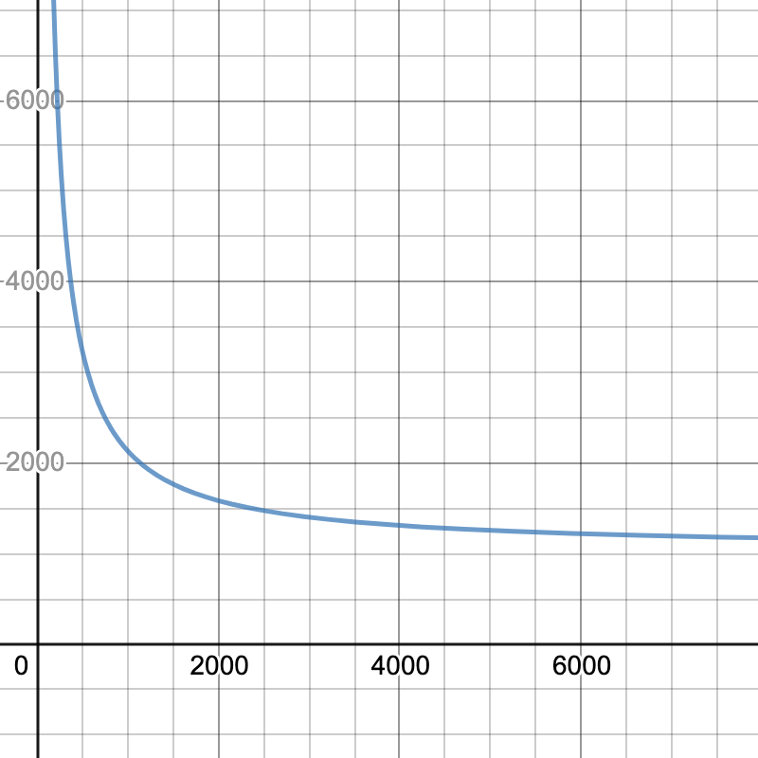
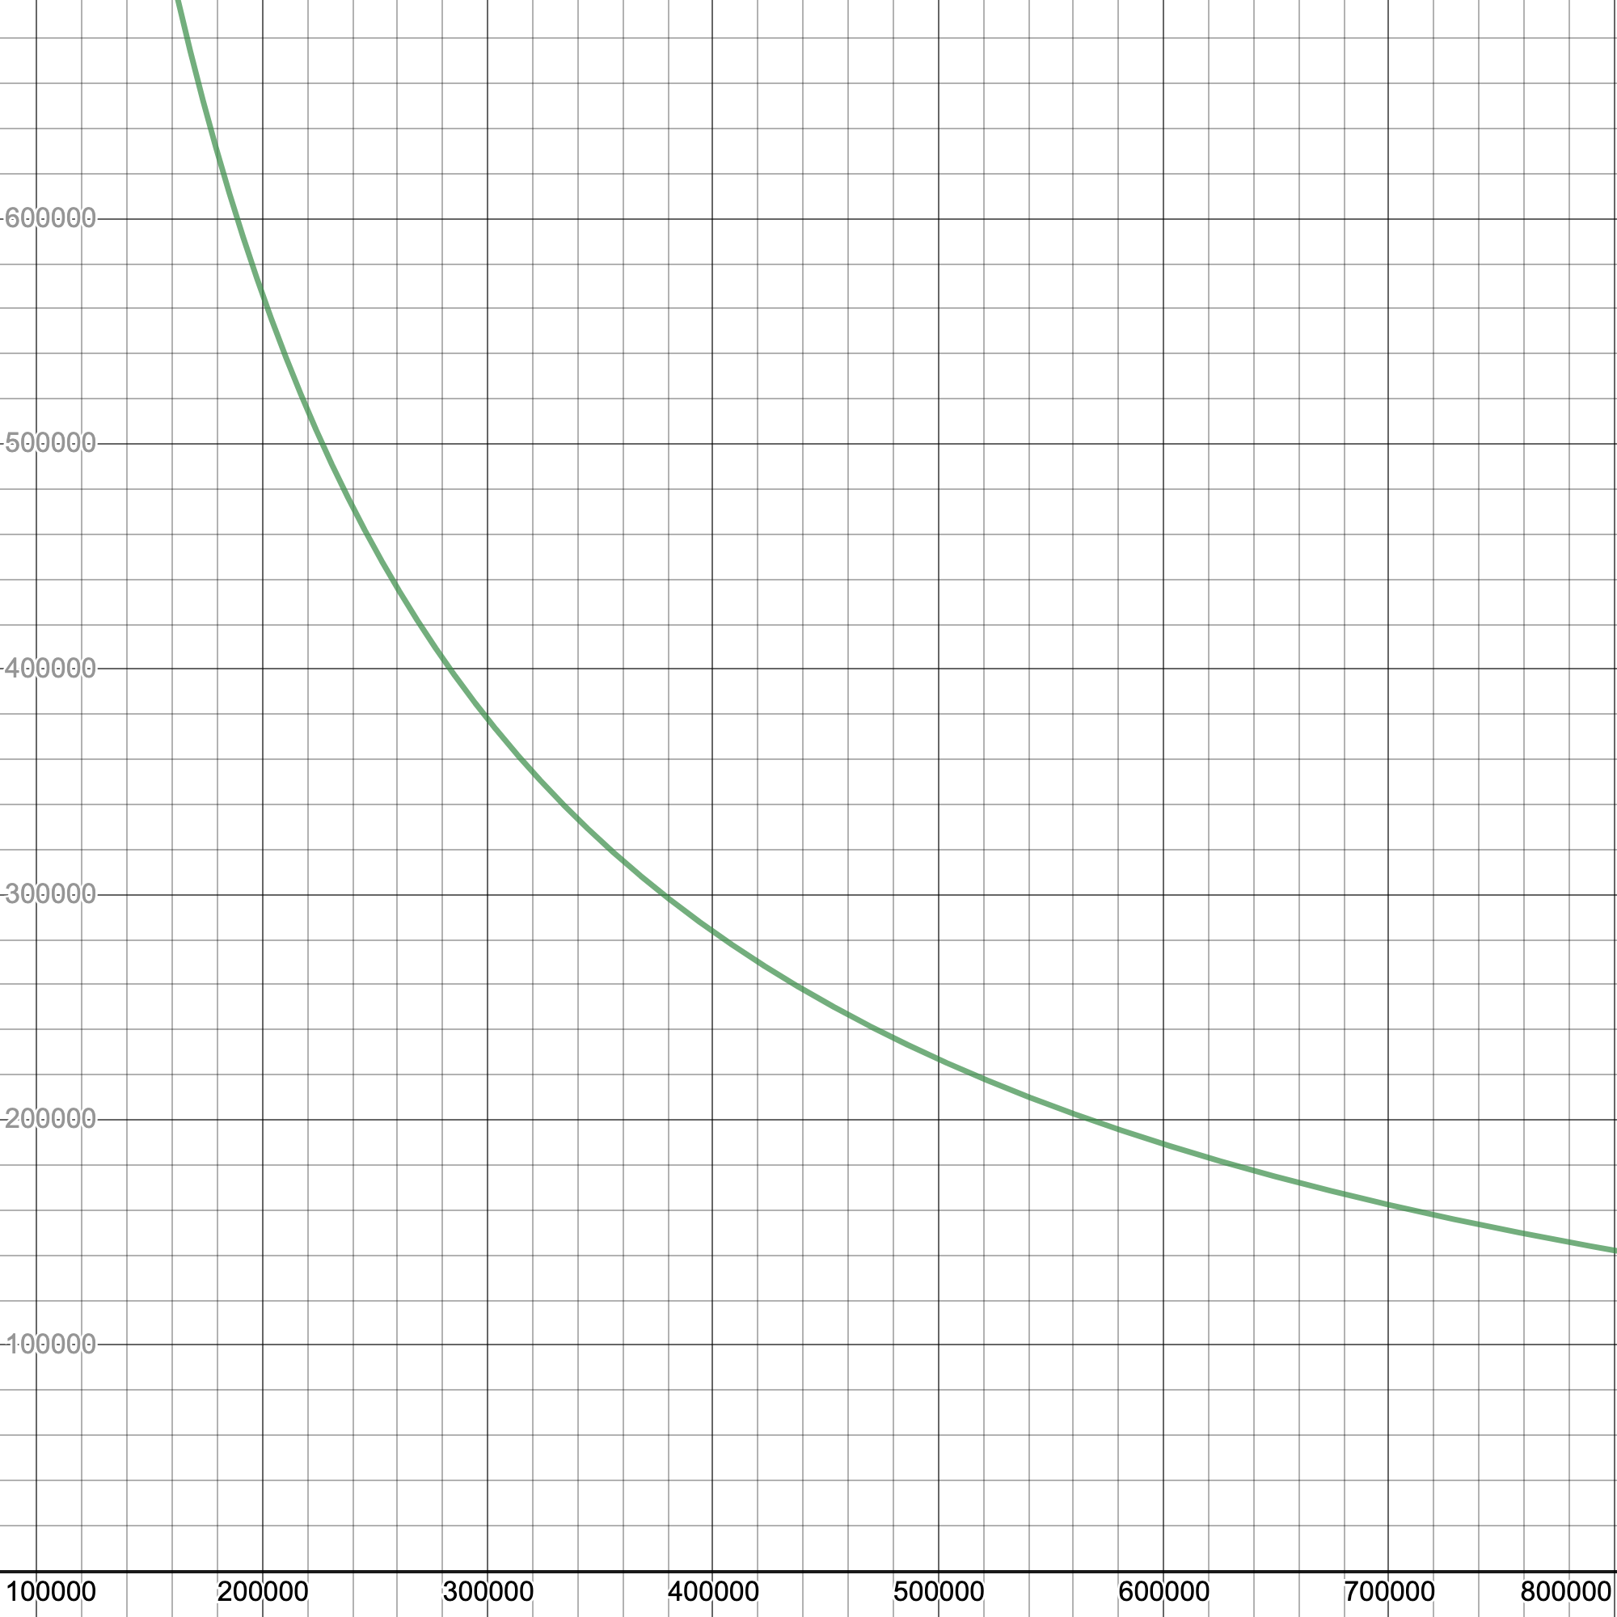
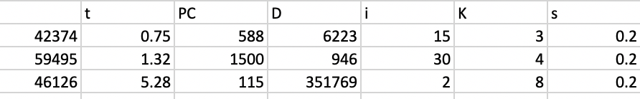
2018 Bid Data
42374
59495
46126

Slide 30
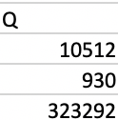
2018 Bid Data
42374
59495
46126

Slide 31
Summary
Output:
Predicted Win-rate of a given item & conditions
Forecasted demand of product/family
Optimized replenishment quantity (Q) and interval (k) for TCR minimization.

Slide 32
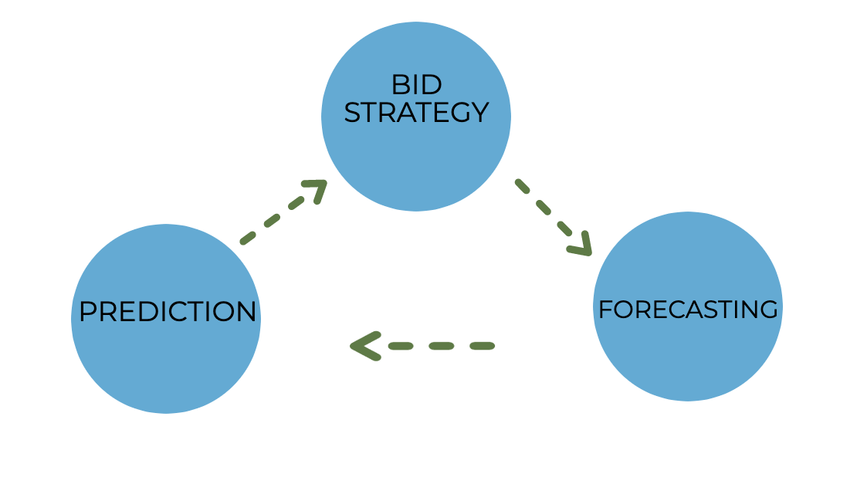
Summary
BID RESPONSE
BID REQUEST
WIN/LOSE

